Slide 1
Secure Coding Practices

Slide 2
Introductions
Justin Goodhart
Developer in an Information Security Team
Learning how to be a Security Analyst

Slide 3
Generally, it is much less expensive to build secure software than to correct security issues after the software package has been completed, not to mention the costs that may be associated with a security breach.
https://www.owasp.org/images/0/08/OWASP_SCP_Quick_Reference_Guide_v2.pdf

Slide 4
Confidentiality, Integrity, and Availability (CIA)
The goal of software security is to maintain the confidentiality, integrity, and availability of information resources in order to enable successful business operations.

Slide 5
Confidentiality
To ensure that information is disclosed only to authorized parties.

Slide 6
Integrity
The assurance that information is accurate, complete and valid, and has not been altered by an unauthorized action.

Slide 7
Availability
A measure of a system's accessibility and usability.

Slide 8
Other Popular Trilogies
Information Objectives (Already mentioned)
Confidentiality, Integrity, and Availability (CIA)
Scenario Goals
Prevent, Detect, and Respond
Management Methodology
People, Process, and Technology

Slide 9
General Security Principles

Slide 10
Least privilege
The principle of least privilege means giving a user account only those privileges which are essential to that user's work and nothing more.

Slide 11
Simple is more secure
The larger and more complex that a system becomes the harder it becomes to secure. Larger systems have more areas of concern. More complex systems increase the likelihood of bugs or of making mistakes. Simpler is always more secure.

Slide 12
Never trust users
You should consider and be on guard against basic human mistakes. In general, you should be paranoid. Most users aren't out to get you, but one in 10,000 might be, and the thing is, you can't tell the difference, especially ahead of time.

Slide 13
Expect the unexpected
Security's not like chess where you can react to someone else's moves. You have to assume that you will be hacked and your job is to figure out how that will happen ahead of time. You have to prevent the crime before it happens. It's sometimes called a mystery in reverse.

Slide 14
Defense in depth
Originally defense in depth was a military term. The idea is to slow the advance of an attacker because over time an attack loses momentum, and therefore it's not as effective.

Slide 15
Defense in depth continued…
When we're talking about computers, we're talking about redundant security. There are three main areas that you'll want to focus on for defense in depth. And you want to have defense in all of these areas, and have it deeply in all of these areas as well.
People
Technology
Operations

Slide 16
Defense in depth (People)
Defense in depth for people means:
Writing a security policy
Getting everyone educated
Getting them to follow best practices
Assigning responsibilities

Slide 17
Defense in depth (Technology)
Now when we talk about technology we're talking about having security throughout your entire technology stack. That is:
Hardware
Software
Acquisition
Maintenance

Slide 18
Defense in depth (Technology) continued…
Defense in depth in technology touches on:
Firewalls
Intrusion detection
Server hardware
Software

Slide 19
Defense in depth (Operations)
Defense in depth for operations means:
Periodic security reviews
Data handling procedures
Monitoring responsibilities
Establishing how do you respond to threats.

Slide 20
Multi-layered defense
Layered security, also known as layered defense, describes the practice of combining multiple mitigating security controls to protect resources and data.
The term bears some similarity to defense in depth, a term adopted from a military strategy that involves multiple layers of defense that resist rapid penetration by an attacker but yield rather than exhaust themselves by too-rigid tactics.
Layered security is regarded by some as merely a delaying tactic used to buy time to bring security resources to bear to deal with a malicious security cracker's activities.

Slide 21
Security through obscurity
The less information you give out the better. More information benefits hackers. Hackers rely on exposed information and feedback from their actions.

Slide 22
Security through obscurity continued…
Information helps the hacker by narrowing the field of possible exploits. So you want to limit exposed information. Don't report any more information than is absolutely necessary. It's similar to the idea of least privilege, but this is least information.

Slide 23
Security through obscurity continued…
However, some people misinterpret security obscurity to mean that it's a good idea to use random or fake filenames or directory names to confuse hackers.
There's a huge penalty to you and anyone who's working on the site if things are confusing, and possibly even to your overall security because this violates our other principle, that simple is more secure.

Slide 24
Security through obscurity continued…
As a side note to security through obscurity:
Information that is shared through poor configuration management of the environment can add up to an exploit. The information you share through the application code is not everything the attacker is going to go after.

Slide 25
Blacklisting
Blacklisting is listing what is forbidden.
We have to remember to add to our blacklist when new items come up.

Slide 26
Whitelisting
Whitelisting is listing what is permitted instead of what is forbidden.
Whitelisting means restricted by default (more secure than blacklisting). We don’t have to do anything extra when new items are discovered.

Slide 27
Blacklisting and whitelisting
The choice to use whitelisting or blacklisting comes up in many different security areas. Learn to recognize it as a pattern when you see it, so that you can make a smart choice about which one to use.
When possible it is recommended to use the whitelisting approach. Security by default.

Slide 28
Map exposure points and data passageways
Mapping the exposure points and passage ways is a big part of the awareness side of things. If we could be aware of where they are, then we can make sure that they're protected.
It also helps us to expect the unexpected.

Slide 29
Threat Modeling

Slide 30
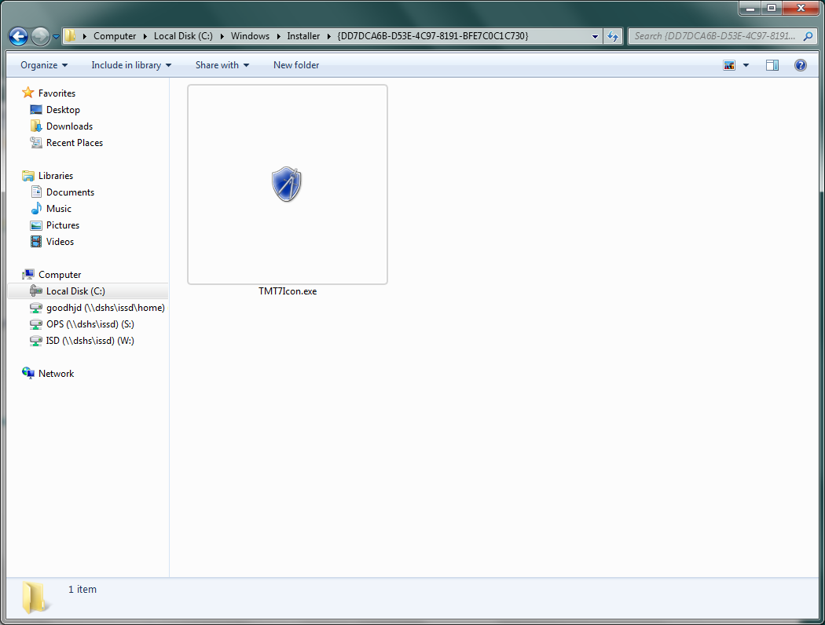
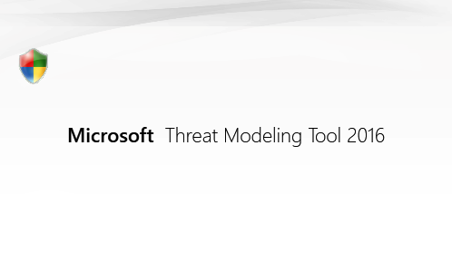
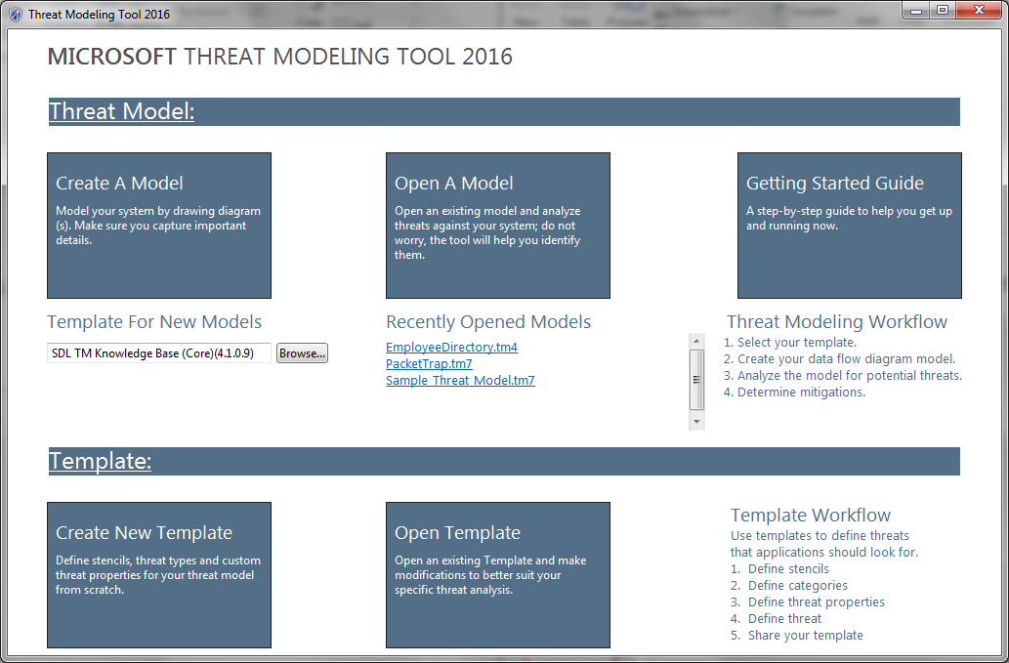
Microsoft Threat Modeling Tool 2016

Slide 31
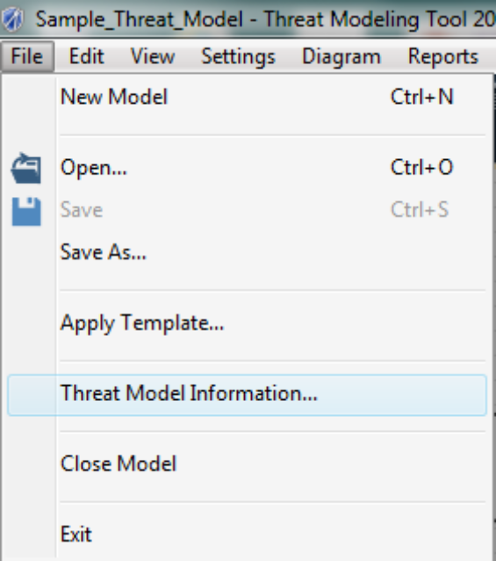
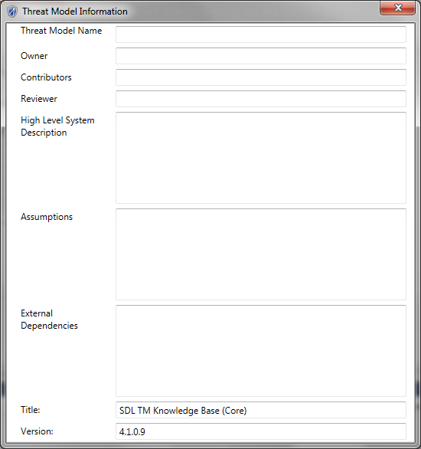
Fill in the threat model information

Slide 32
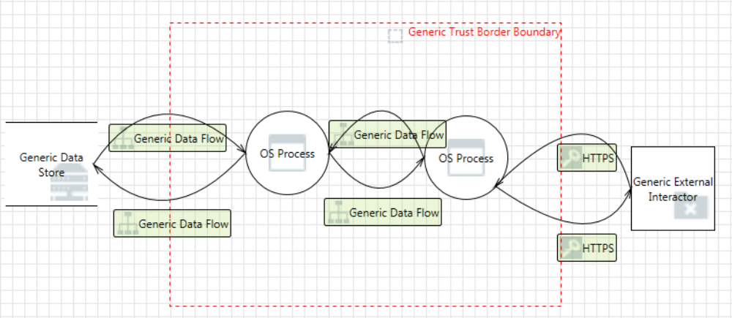
Diagram the system

Slide 33
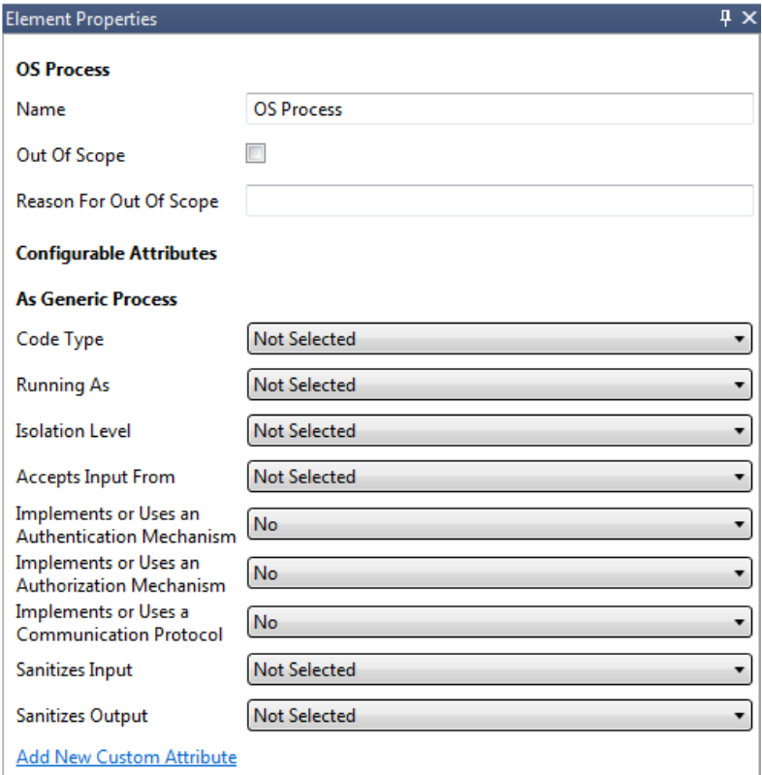
Fill in the properties

Slide 34
Determine and rank threats
Switch from Design View to Analysis View to see the identified threats.
Ranking the Threats is a simple dropdown for each of the generated threats in the Threat Modeling Tool and if there are questions on the rank level we can work with the Security Team.

Slide 35
STRIDE
Spoofing
Tampering
Repudiation
Information disclosure
Denial of service
Elevation of privilege

Slide 36
Spoofing
To illegally access and use another user's credentials, such as username and password.
Mitigations:
Strong authentication
Hash validation
Protecting data in transit
Protecting data at rest

Slide 37
Tampering
To maliciously change/modify persistent data, such as persistent data in a database, and the alteration of data in transit between two computers over an open network, such as the Internet.
Mitigations:
Access control lists
Digital signatures
Message authentication codes
Integrity controls

Slide 38
Repudiation
To perform illegal operations in a system that lacks the ability to trace the prohibited operations.
Mitigations:
Strong authentication
Secure logging and auditing
Digital signatures
Time stamps
Trusted third party

Slide 39
Information disclosure
To read a file that one was not granted access to, or to read data in transit.
Mitigations:
Protecting data in transit
Protecting data at rest
Access control lists
Encryption

Slide 40
Denial of service
To deny access to valid users, such as by making a web server temporarily unavailable or unusable.
Mitigations:
Access control lists
Filtering
Load balancing
Authorization
High-availability designs
Quotas and rate limits

Slide 41
Elevation of privilege
To gain privileged access to resources for gaining unauthorized access to information or to compromise a system.
Mitigations:
Input validation
Setting permissions
Group or role membership
Access control lists

Slide 42
Security Controls/Mitigation

Slide 43
Input Validation
A user or client will not always submit data your application will expect. By building robust applications that do not trust user input by default, you ensure the application will be able to handle unexpected data gracefully.
Field Validation:
Data Type Validation
Required Validation
Regular Expression Validation

Slide 44
Output Encoding
Encoding, closely related to Escaping is a powerful mechanism to help protect against many types of attack, especially injection attacks and Cross-site Scripting (XSS). Essentially, encoding involves translating special characters into some equivalent that is no longer significant in the target interpreter.
Treat content as content and not executable code.

Slide 45
Parameterized Queries
A parameterized query is a query in which placeholders are used for parameters and the parameter values are supplied at execution time.
Examples:
Stored Procedures (without string concatenation)
SQL Commands with SQL Parameters instead of string concatenation
Data Access Frameworks that use parameterized queries
Still treating content as content and not executable code.

Slide 46
SQL Injection
Reasons not to stop SQL Injection:
Laziness?
Stubbornness?
As simple as using parameterized queries yet year after year injection is the number one threat.

Slide 47
Other Types of Injection
Xpath Injection
LDAP Injection
NoSQL Injection
OS Commands
XML Parsers
SMTP Headers
Code injection is the exploitation of a computer bug that is caused by processing invalid data. Injection is used by an attacker to introduce (or "inject") code into a vulnerable computer program and change the course of execution.

Slide 48
Request Tokens
Characteristics of a Request Token
  Unique per user & per user session
  Tied to a single user session
  Large random value
  Generated by a cryptographically secure random number generator
The request token is added as a hidden field for forms or within the URL if the state changing operation occurs via a GET
The server rejects the requested action if the request token fails validation

Slide 49
Authentication
U.S. National Institute of Standards and Technology (NIST) Special Publication 800-53 (SP800-53) defines authentication as verifying the identity of a user, process, or device, often as a prerequisite to allowing access to resources in an information system.

Slide 50
Authorization
Ensuring that access to assets is authorized and restricted based on business and security requirements. Areas to apply Access Control Lists (ACLs):
applications or APIs;
specific application screens or functions;
specific data fields;
memory;
private or protected variables;
storage media;
transmission media;
In short, any object used in processing, storage or transmission of information.

Slide 51
Cookie Management
It's possible for an attacker to steal and reuse session identifiers or other sensitive cookie values when they are stored or transmitted insecurely.
It's possible for an attacker to tamper with session identifiers or other sensitive cookie values when they are stored or transmitted insecurely.
Protect and validate cookies.

Slide 52
Session Management
The disclosure, capture, prediction, brute force, or fixation of the session ID will lead to session hijacking (or sidejacking) attacks, where an attacker is able to fully impersonate a victim user in the web application.
Protect and validate session variables.

Slide 53
Configuration Management
There are a wide variety of server configuration problems that can plague the security of a site. These include:
Unpatched security flaws in the server software
Server software flaws or misconfigurations that permit directory listing and directory traversal attacks
Unnecessary default, backup, or sample files, including scripts, applications, configuration files, and web pages
Improper file and directory permissions
Unnecessary services enabled, including content management and remote administration

Slide 54
Configuration Management Continued…
Default accounts with their default passwords
Administrative or debugging functions that are enabled or accessible
Overly informative error messages
Misconfigured SSL certificates and encryption settings
Use of self-signed certificates to achieve authentication and man-in-the-middle protection
Use of default certificates
Improper authentication with external systems

Slide 55
Error Handling
An important aspect of secure application development is to prevent information leakage. Error messages give an attacker great insight into the inner workings of an application.
The purpose of reviewing the Error Handling code is to assure the application fails safely under all possible error conditions, expected and unexpected. No sensitive information is presented to the user when an error occurs.

Slide 56
Logging and Auditing
Auditable – all activities that affect user state or balances are formally tracked
Traceable – it’s possible to determine where an activity occurs in all tiers of the application
High integrity – logs cannot be overwritten or tampered with by local or remote users
Fail safe – do not fail open

Slide 57
Cryptography
Cryptography (or crypto) is one of the more advanced topics of information security
It is difficult to get right because there are many approaches to encryption
In addition, serious cryptography research is typically based in advanced mathematics and number theory, providing a serious barrier to entry.
The proper and accurate implementation of cryptography is extremely critical to its efficacy.
A small mistake in configuration or coding will result in removing a large degree of the protection it affords and rending the crypto implementation useless against serious attacks.

Slide 58
Least Privilege
The principle of least privilege recommends that accounts have the least amount of privilege required to perform their business processes. This encompasses user rights, resource permissions such as CPU limits, memory, network, and file system permissions.

Slide 59
Resources
Build Security In (DHS)
Open Web Application Security Project (OWASP)
Microsoft’s Security Development Lifecycle (SDL)
Microsoft Threat Modeling Tool 2016

Slide 60

Build Security In
Build Security In is a collaborative effort that provides practices, tools, guidelines, rules, principles, and other resources that software developers, architects, and security practitioners can use to build security into software in every phase of its development.
https://buildsecurityin.us-cert.gov/

Slide 61
Build Security In continued…
Consistent with this list is the Top 10 Project by the Open Web Application Security Project (OWASP). OWASP’s report captures the top ten risks associated with the use of web applications in an enterprise.

Slide 62
OWASP
The Open Web Application Security Project (OWASP) is a 501(c)(3) worldwide not-for-profit charitable organization focused on improving the security of software. Our mission is to make software security visible, so that individuals and organizations worldwide can make informed decisions about true software security risks.
https://www.owasp.org

Slide 63
OWASP Top 10
The OWASP Top Ten is a powerful awareness document for web application security. The OWASP Top Ten represents a broad consensus about what the most critical web application security flaws are. Project members include a variety of security experts from around the world who have shared their expertise to produce this list.
https://www.owasp.org/index.php/Category:OWASP_Top_Ten_Project

Slide 64
Security Development Lifecycle (SDL)
[Microsoft]
The Security Development Lifecycle (SDL) is a software development process that helps developers build more secure software and address security compliance requirements while reducing development cost
https://www.microsoft.com/en-us/sdl/

Slide 65
Microsoft Threat Modeling Tool 2016
Microsoft Threat Modeling Tool 2016 is a tool that helps in finding threats in the design phase of software projects.
Microsoft Threat Modeling Tool 2016 Download:
http://www.microsoft.com/en-us/download/details.aspx?id=49168

